Slide 1
Analysis Without Paralysis
Terryn Valikodath | “ChocolateCoat”

Slide 2


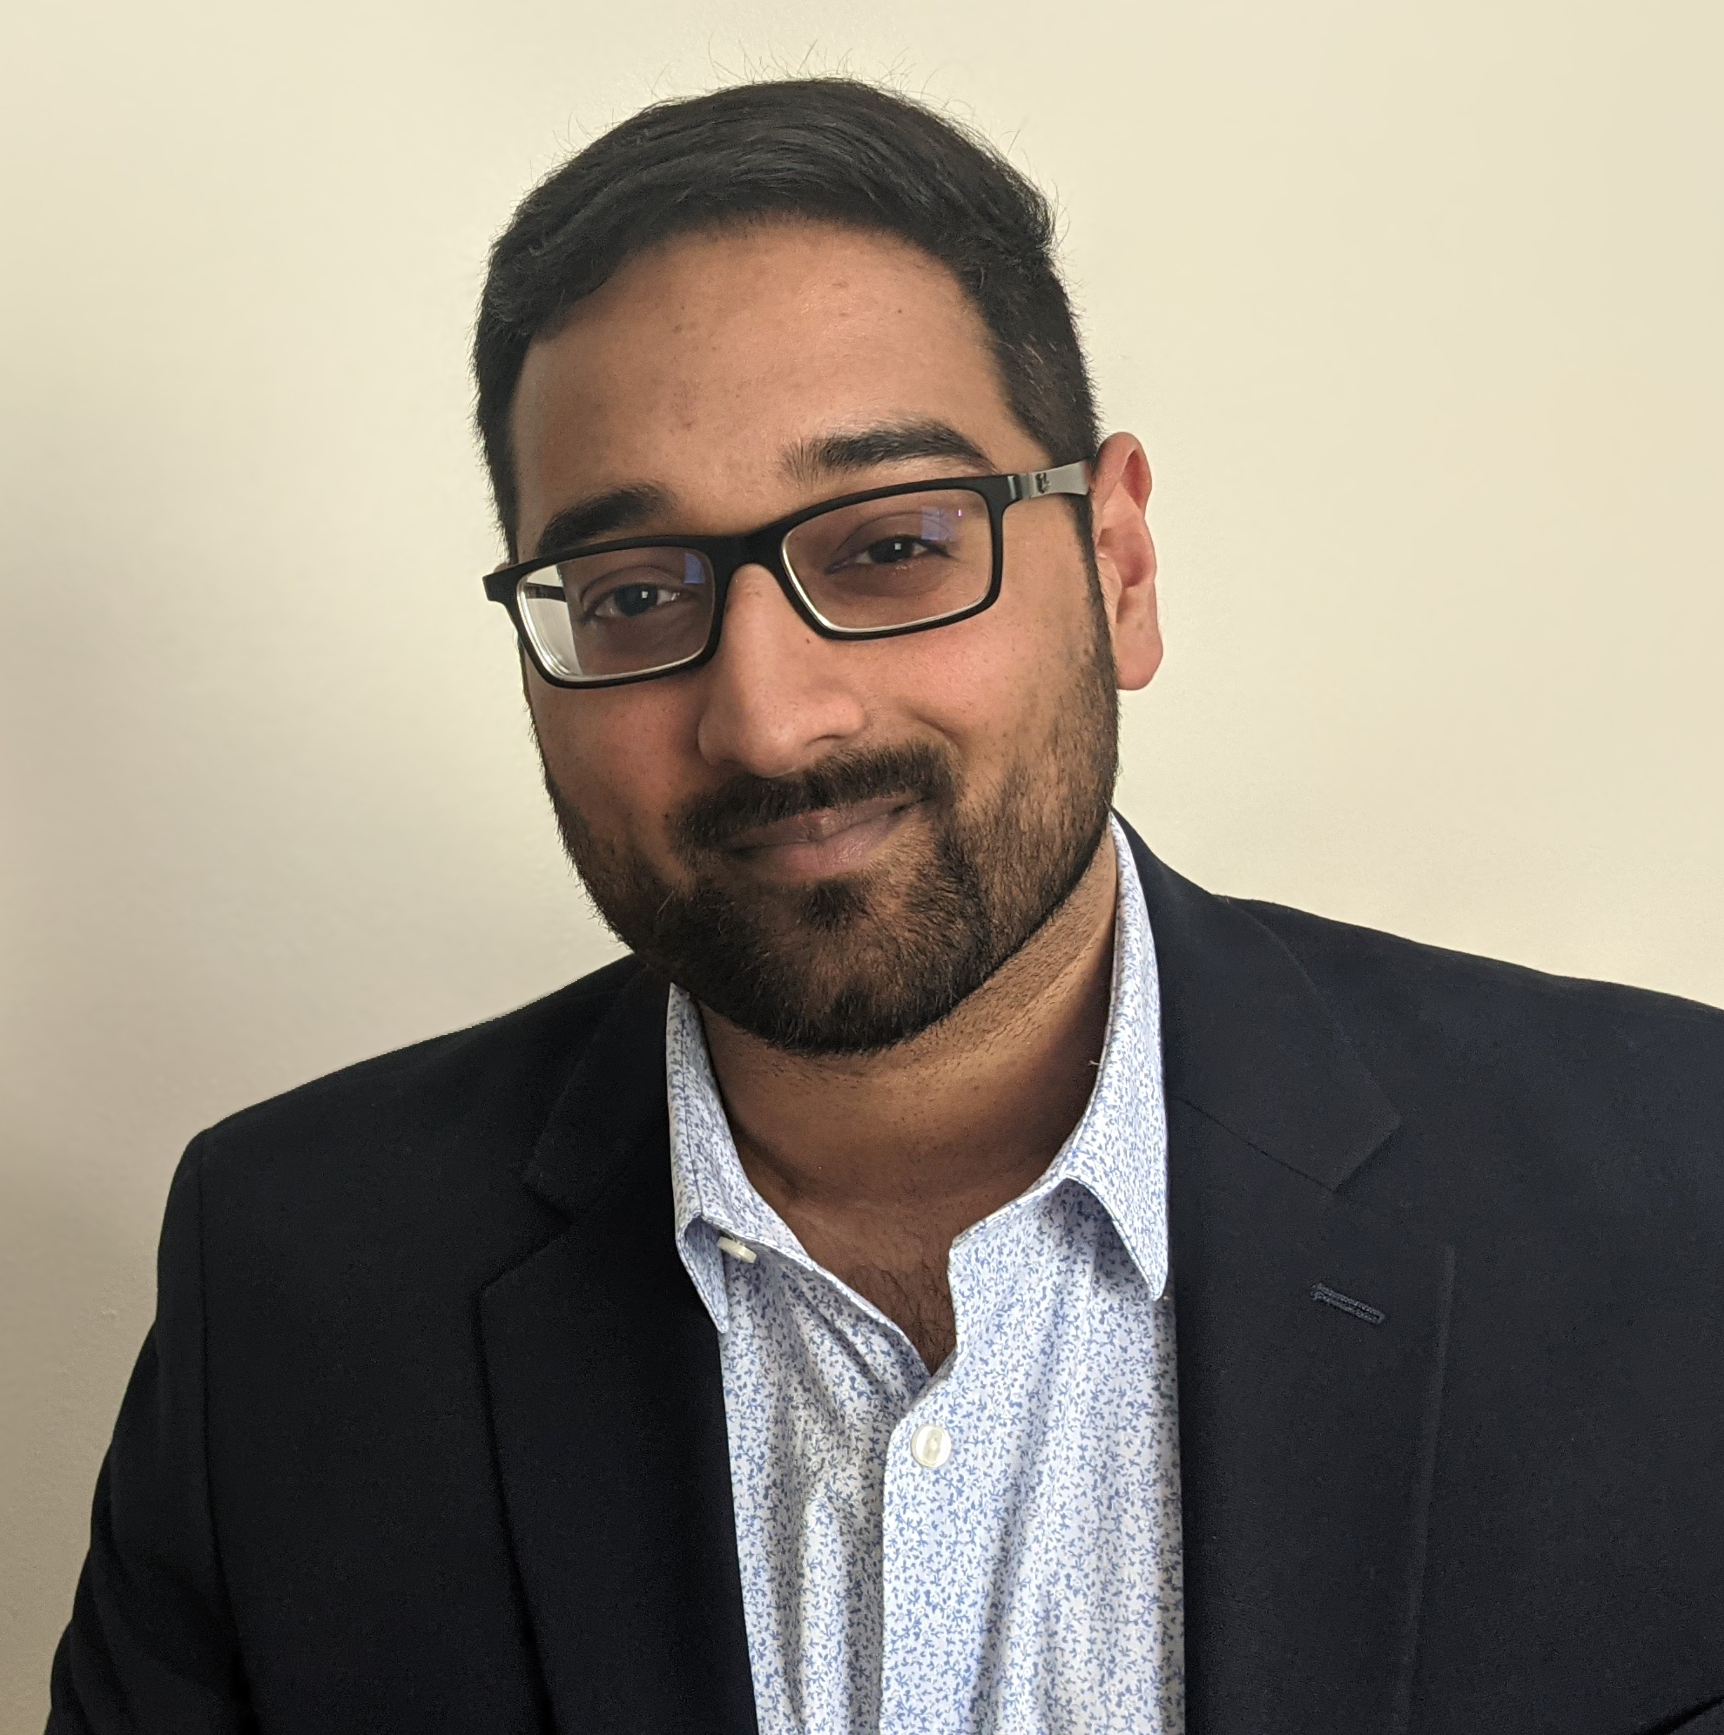
Terryn Valikodath
“ChocolateCoat”
https://chocolatecoat4n6.com
DFIR all day, everyday
You’ll see me on your worst day ☺
How I got here
Rooting and jailbreaking
Living in books
Help Desk > General IT > Sysadmin > Cybersecurity > DFIR
DFIR Consultant
Cisco Talos Incident Response

Slide 3
Why do you need structure in analysis?
“Jumping In” leads to burnout
Give realistic expectations to your peers/managers
Investigation is not taught often

Slide 4
Background

Slide 5
=
What is an investigation?
Investigations are all about moving from the
unknown, to the known, and then further to the provable.
Observation
Question
Hypothesis
Answer
Conclusion

Slide 6

Standards of a Successful Investigation
"Success should be based on the quality of the analysis, the completeness of the investigation, and if we were able to accomplish the objective, based on the technical and time constraints that were in play"

Slide 7



MITRE ATT&CK
Used for threat intelligence, checking your defenses and threat hunting
Tactics
Techniques
Procedures
The adversary’s technical goal category
“Persistence”
How the adversary achieves their goals
“T1053: Scheduled Task/Job”
Implementation of the techniques
“Earth Lusca used the command
schtasks /Create /SC ONLOgon /TN WindowsUpdateCheck /TR "[file path]" /ru
system for persistence”

Slide 8
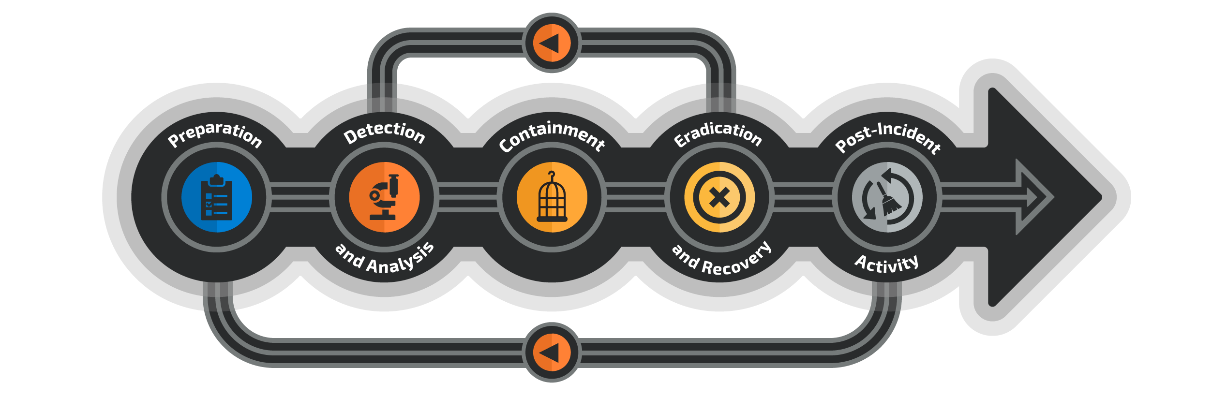
Incident Response Cycle

Slide 9
Analysis Flow
Notes:
Analysis is not one thing
We often say it like it is just one specific task, but it has many components

Slide 10
=
Analysis Flow
Add structure and a plan to your analysis
Investigation Strategy
Findings
Correlation
Timeline
Enrichment

Slide 11
Investigation Strategy
Organize and document evidence
Don’t rush into an investigation without a plan
Establish a clear task list, know the scope
Understand your actual objective
Utilize indicators to identify TTPs
Use a template, nobody likes a blank screen
Create a strategy to meet determined objectives.
What are you analyzing?
Who is analyzing it?
When should you report initial findings?

Slide 12

Know where to look
Logs
If you don’t have evidence, it didn’t happen.
Ideally, you need to take the time to scope the situation.
Don’t forget, a lack of evidence may also be evidence.
Security Tools
Triage
Evidence Sources
Intelligence
Forensic Analysis
Notes:
Write out findings in “report format” this eases the process of writing a report and allows you speak on findings during a conversation
Understand the timestamp of your data source and always try to convert to UTC when possible
Develops consistent timeline

Slide 13

Finding Evil
A baseline of expected activity will make it easier to identify suspicious behaviors
Use the hypothesis approach to set end points.
There will likely be several paths to follow.
Note them down, but finish your current hypothesis
Hunting
Malicious behavior may not always be identified before your analysis begins.

Slide 14



Quick Wins
Not holistic, use cheat sheets and reference material to complete your analysis
Rogue Connections
Unusual Proceses
Unusual Services
Network activity and logins
Ongoing execution tied to a user account
Execution that does not require user interaction
Rogue Accounts
Unusual Files
AutoStart Locations
Unknown or unexpected user accounts
Creation, modification or deletion of unknown files or directories
Locations where files, scripts, or processes can be executed upon boot or trigger

Slide 15
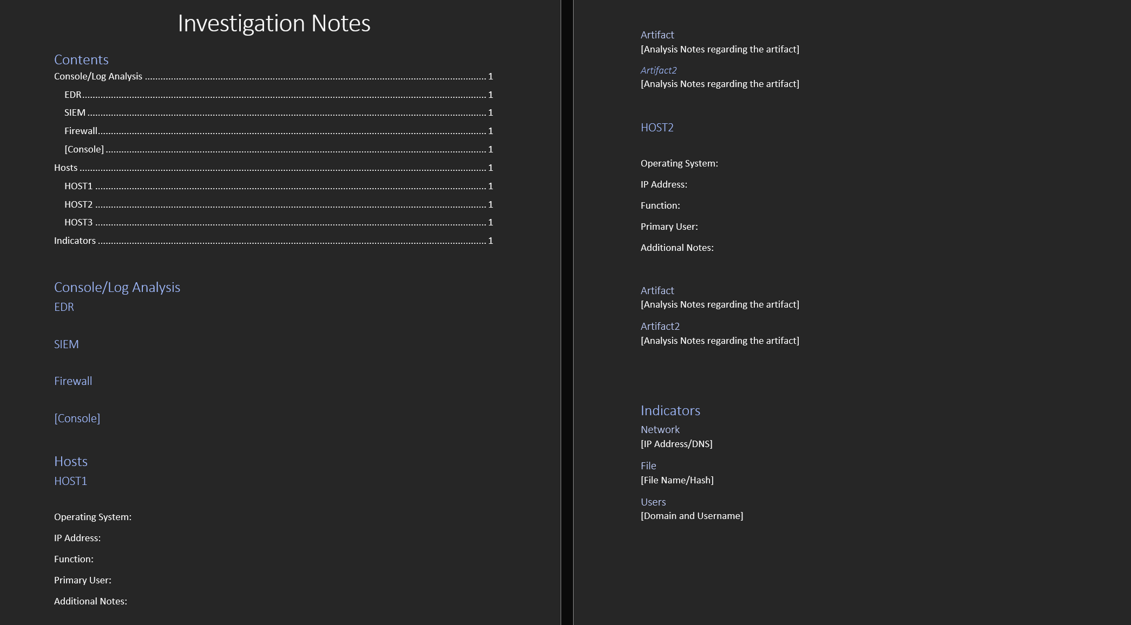
Investigation Notes Template
Get your copy on my Github

Slide 16
Findings
Timestamp
Organize your findings by the evidence source
Write out findings in “report format”
Write them for the audience
UTC all day, everyday
Code
Source
Findings
Context
Event Description
Notes:
Write out findings in “report format” this eases the process of writing a report and allows you speak on findings during a conversation
Understand the timestamp of your data source and always try to convert to UTC when possible
Develops consistent timeline

Slide 17
Correlation
Take individual events and see how they fit together
Correlate multiple evidence sources
Analyze alongside the MITRE ATT&CK Framework to identify relevant TTPs
What is the chain of events?
Begin to record the indicators and timestamps in a central location.
Ensure that proper context is provided – why is this important?
Notes:
Finish the puzzle and look for missing pieces

Slide 18

Indicators
Network
They come in all shapes and sizes
Let your Intelligence team/partners in on the fun
Keep a list of indicators for future searches
Indicators
Identifier
File
Account

Slide 19
Simplify
Use standard time notation for events
ISO-8601 in UTC
2022-01-01T12:34:56Z
Use consistent terminology to identify similar fields from difference log sources.
Connected IP or Source Network Address = Source IP
Write it like you're writing for someone who doesn’t know what your job is
Consistency
Standardize your notes and findings

Slide 20
Creating a Timeline
Take your findings and input them into a table (CSV or Excel)
Allows for the creation of a sequence of events
Headers
Timestamp (UTC)
Host
Source
Event Type
Description
MITRE (optional)
Tools:
Excel
Powepoint
When did key events take place?
Standardized timestamps of important indicators but keep the output separate.

Slide 21
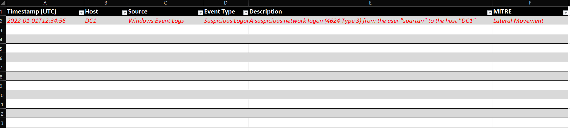
Incident Timeline Template
Get your copy on my Github

Slide 22
Enrichment
It is not intended to be exhaustive or comprehensive
MITRE ATT&CK provides a useful framework for documenting common TTP’s often leveraged by adversaries.
What intelligence exists around the identified TTPs and indicators?
Have we or someone else seen this before?
Apply existing intelligence to your findings

Slide 23
Summary
Look at all the great work you’ve done
Setup time to debrief with peers
Documented investigations are great drivers for necessary change
Take a breath and pat yourself on the back!
Step away every now and then to regroup
Know your limits
Ask for help
Report
Timeline
Accomplishments
The final report is 80% complete.
A document you can speak to when asked
No need to rely on just memory
Easy to digest chain of events
Looks great in a final report
Document other folks can contribute to
List of evidence you analyzed
Proof of your hard work
Notes that will impress everyone

Slide 24
THANK YOU!
Questions?
Socials
More Content
@CyberCoat on Twitter
@ChocolateCoat everywhere else (Mastodon, Github, etc)
Best way to contact me for questions about absolutely anything and ramblings
https://github.com/chocolatecoat/DFIR-Templates
Templates for Scoping, Forensic Notes, and Reports.
Always open to more ideas of what may be helpful.
https://chocolatecoat4n6.com/
Blog discussing several topics around DFIR and a little bit of more general forensics.

